Slide 1
Sprint 2 Status FINAL UPDATE
Integrating data catalogs with content search technologies
Datasets
Team : MindBots
Week 7
Date 3/6/2023

Slide 2
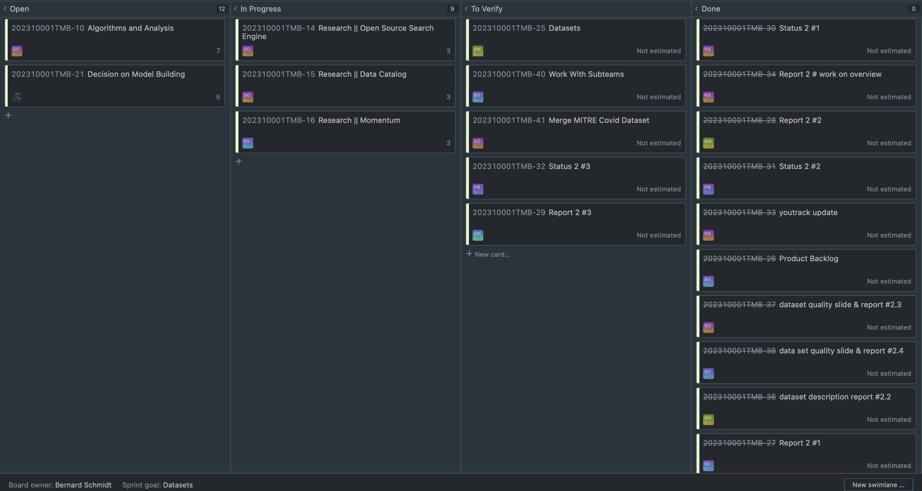
YouTrack

Slide 3
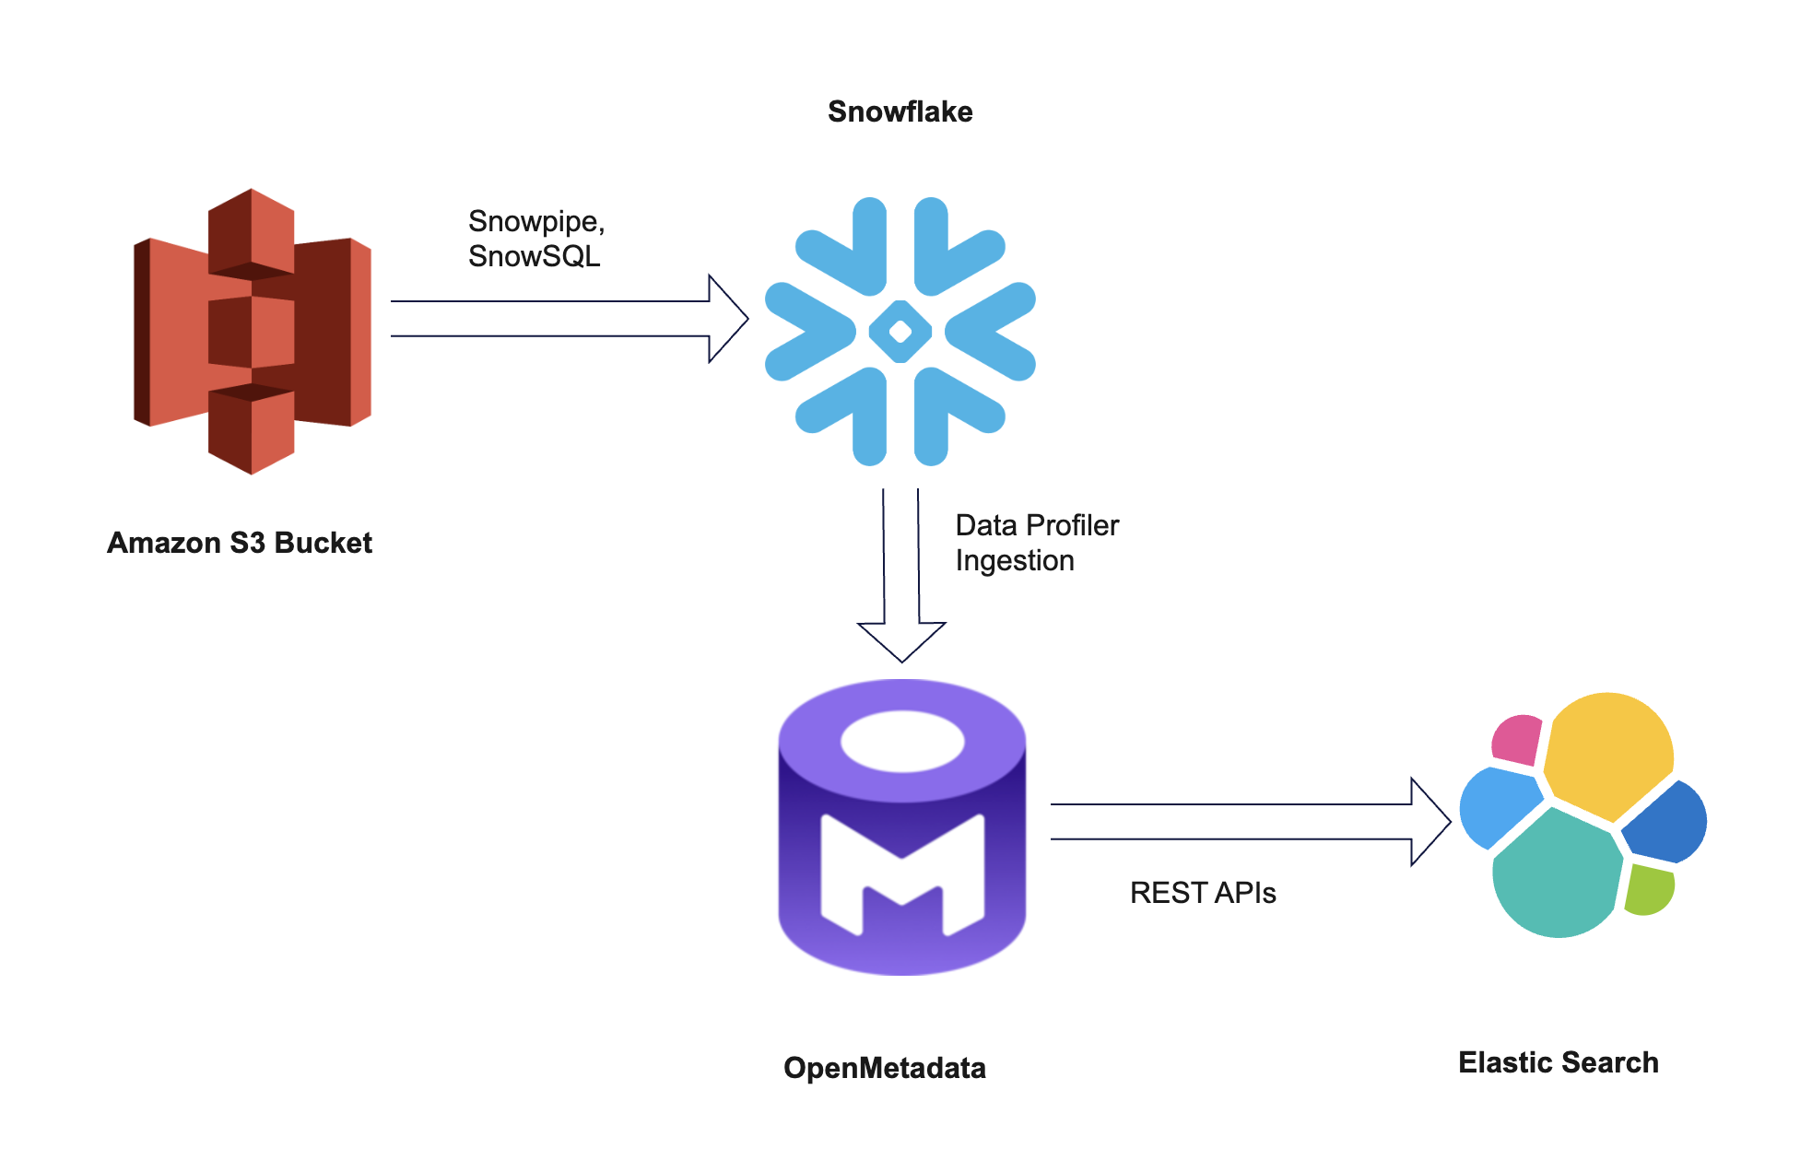
Architecture

Slide 4
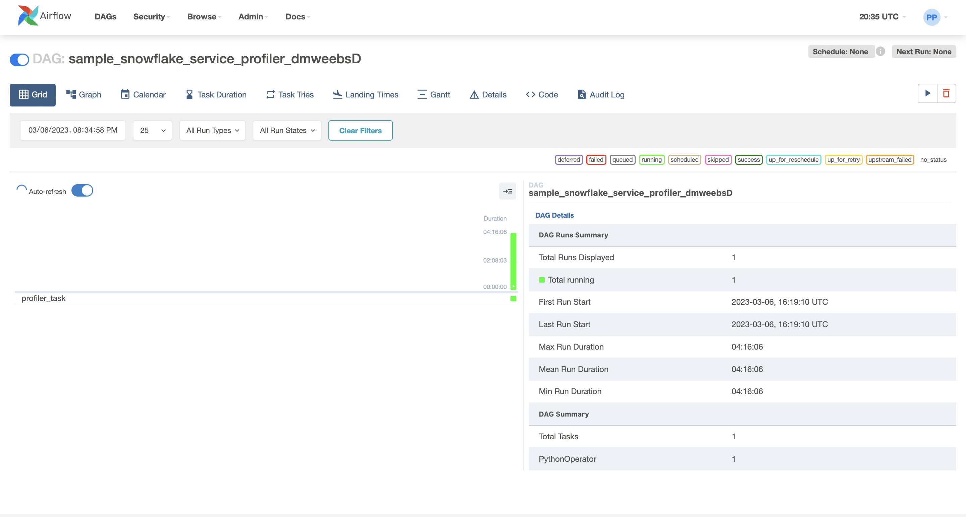
Airflow dag

Slide 5
Risks and Planned Mitigations
Risk Name | Description | Probability | Impact | Mitigation
Connectivity | Connecting data and results from one Software to Other which are on different Hosts. | low | medium | Usage of Pipelines, DAGs, and REST APIs
Privacy | A normal user using the search engine might access high level results produced by the search engine. | medium | medium | Using levels of Access can improve privacy

Slide 6
Weekly Partner Meeting
Partner name [Primary Partner POC]
Team Progress from Prior Week
Team Tasks for Current Week
Other Items Discussed
Instructions: Each week the team is expected to meet with their project partner. The project team is expected to take copious notes of the meeting and what was discussed – just as would take place in any consulting services client meeting engagement.
The first partner meeting will be primarily a Q & A session between the partner and the team – with the team asking detailed and probing questions regarding the problem statement and any specialized subject matter knowledge the partner has relative to the problem domain.
Thereafter, project teams should be reporting on three things each week:
Team Progress from Prior Week
Team Tasks for Current Week
Other Items Discussed
This slide summarizes for the rest of the class what the project team presented to the partner – as well as any other items discussed during the meeting.

